Slide 1

BIRD OBSERVATION AND ENVIRONMENTAL ANALYSIS A Python-based Exploratory Data Analysis
Yuvarani

Slide 2
Objective
Main Goal is to perform an in-depth analysis of bird monitoring data collected from forest and grassland ecosystems using Python, with the aim of extracting meaningful patterns related to time, location , species behavior, and environmental conditions.
This project uses Exploratory Data Analysis to uncover patterns in bird observation data.
And focus on seasonal and spatial activity, species diversity, and environmental influences.

Slide 3
Dataset Overview
Files Used:
Bird_Monitoring_Data_FOREST.XLSX
Bird_Monitoring_Data_GRASSLAND.XLSX
Data was extracted from both Excel files, each containing multiple sheets of bird monitoring records.
forest="Bird_Monitoring_Data_FOREST.XLSX"
grassland="Bird_Monitoring_Data_GRASSLAND.XLSX“
forest_dic=pd.read_excel(forest,sheet_name=None)
grassland_dic=pd.read_excel(grassland,sheet_name=None)

Slide 4
Sheets were concatenated and merged into a single unified dataset.
forest_df=pd.concat(forest_dic.values(),ignore_index=True)
grassland_df=pd.concat(grassland_dic.values(),ignore_index=True)
data=pd.concat([forest_df , grassland_df], ignore_index=True)
Inconsistent formats (e.g., date, time, distance) were standardized.
Missing values were handled using appropriate filling techniques (e.g., 'Unknown', 0, or mode or mean or median).
Duplicate records were removed to ensure accuracy.
New features such as Season, Month, and Hour were derived from timestamps.
Duplicate values are removed.

Slide 5
data['Distance'] = data['Distance'].str.strip().replace({' ': ' '}, regex=True)
distance_mapping = {'<= 50 Meters': 25, '50 - 100 Meters': 75}
data['Distance'] = data['Distance'].map(distance_mapping)
data.drop(columns=["Sub_Unit_Code","NPSTaxonCode"],inplace=True)
data['Site_Name'].fillna("Unknown",inplace=True)
data['ID_Method'].fillna(data["ID_Method"].mode()[0],inplace=True)
data['Distance']=pd.to_numeric(data['Distance'],errors='coerce')
data['Distance'].fillna(data["Distance"].median(),inplace=True)
data['Sex'].fillna("Undetermined",inplace=True)
data['AcceptedTSN'].fillna(data['AcceptedTSN'].mode()[0],inplace=True)
data['TaxonCode'].fillna(data['TaxonCode'].mode()[0],inplace=True)
data['Previously_Obs'].fillna(data['Previously_Obs'].mode()[0], inplace=True)
data[data.duplicated()]
data.drop_duplicates(inplace=True)
data.duplicated().sum()
data['Year'].astype(int)
data['Temperature'].astype(float)
data['Year'].astype(int)
data['Visit'].astype(int)

Slide 6
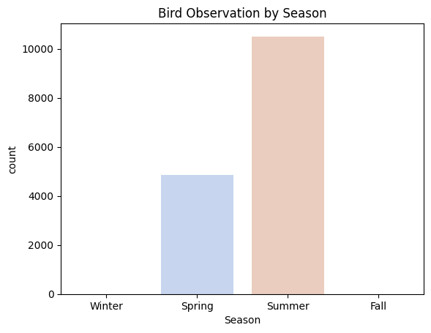
Temporal Analysis
Seasonal Trends: Analyse the Date and Year columns to detect patterns in bird sightings across different seasons or years
Interpretation: Bird sightings peak in Spring and Summer; minimal in Winter due to migration/less activity

Slide 7
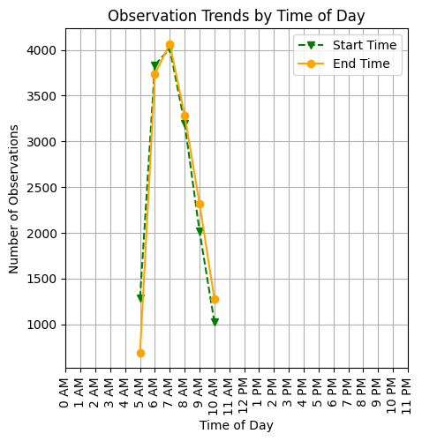
Observation Time: Study the Start_Time and End_Time to determine if specific time windows correlate with higher bird activity.
Interpretation:
observations start early morning (6–9 AM), ideal time for birdwatching
Observation activity drops significantly after 9 AM, suggesting reduced bird visibility or observer availability during later hours.

Slide 8
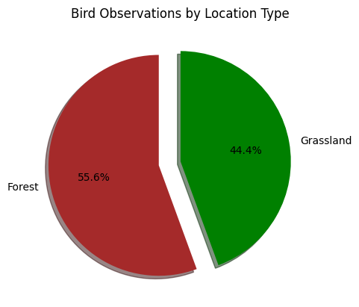
Spatial Analysis
Location Insights: Group data by Location_Type (e.g., Grassland) to identify biodiversity hotspots.
Interpretation:
Forest or Grassland observations dominate; helps target biodiversity areas
Forests are slightly more dominant in bird activity or survey effort.
This could indicate:
Greater species richness in forests, or
More extensive survey coverage in forested areas

Slide 9
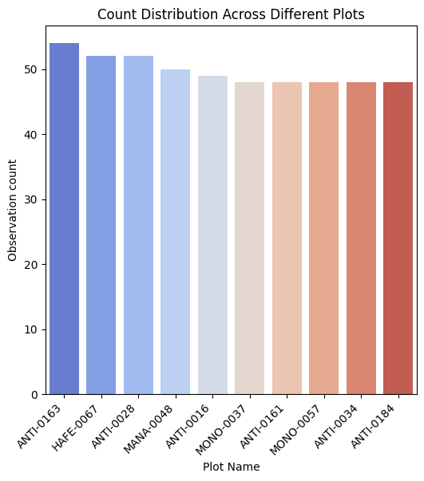
Plot-Level Analysis: Compare observations across different Plot_Name to see which plots attract more species or specific kinds of birds.
Interpretation
The bar chart highlights the top 10 most active plots in terms of bird observations.
These plots either were surveyed more frequently, leading to higher counts.
These findings help in identifying priority monitoring locations.

Slide 10
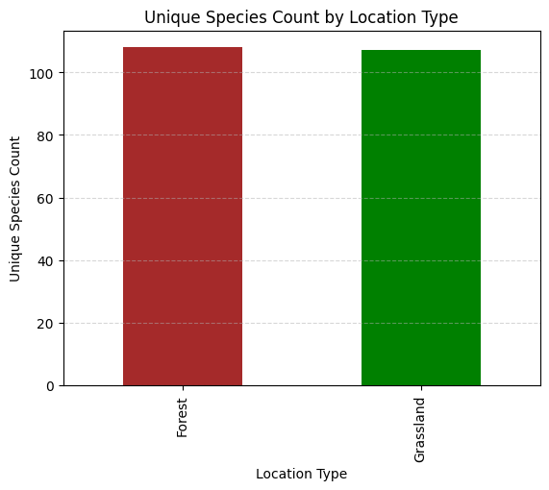
Species Analysis
Diversity Metrics: Count unique species (Scientific_Name) observed and their distribution across Location_Type.
Interpretation
Both habitats show a high level of species diversity, with the Forest having a slightly higher count than Grassland.
This suggests that forests may support marginally more diverse bird communities, possibly due to habitat complexity, vegetation density, or resource availability.

Slide 11
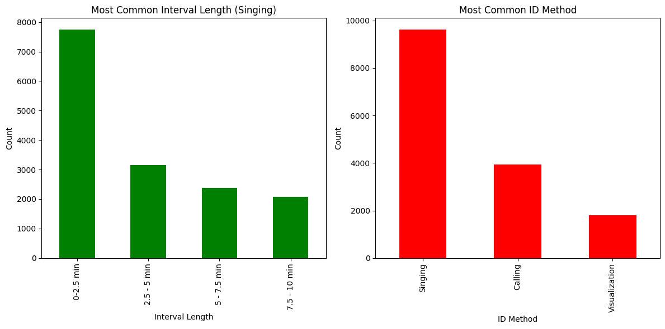
Activity Patterns: Check the Interval_Length and ID_Method columns to identify the most common activity types (e.g., Singing).
Interpretation: The majority of bird singing intervals fall within 0–2.5 minutes

Slide 12
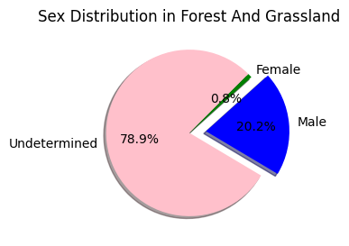
Sex Ratio: Analyze the Sex column to understand the male-to-female ratio for different species.
Interpretation:
A large proportion (78.9%) of bird observations had undetermined sex, likely due to visual or acoustic limitations during field surveys.
Males (20.2%) were more commonly identified than females (0.8%), possibly because males are often more vocal or visually distinctive during the breeding season.

Slide 13
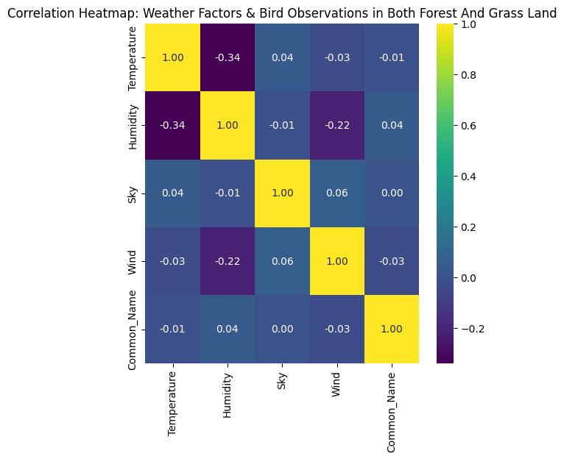
Environmental Conditions
Weather Correlation: Explore how Temperature, Humidity, Sky, and Wind impact observations, such as the number of birds or their distances.
Interpretation:
Weak correlations overall between bird species observations (Common_Name) and weather variables (temperature, humidity, sky, wind).
Temperature and Humidity show a moderate negative correlation (-0.34), indicating that as temperature increases, humidity tends to decrease.
Humidity and Wind also have a mild negative correlation (-0.22).
Bird observations (Common_Name) have very low or negligible correlations with all weather factors (values close to 0), suggesting weather may not significantly affect species presence at the macro level.

Slide 14
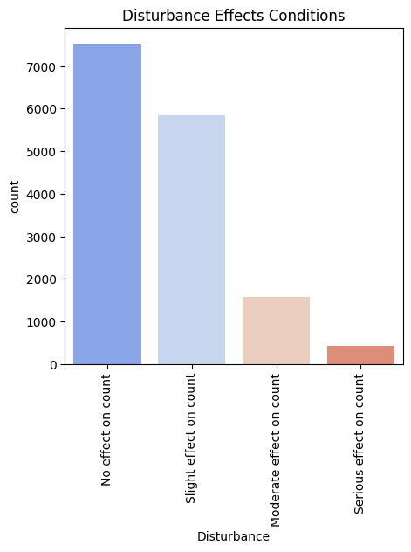
Disturbance Effect: Assess the impact of Disturbance (e.g., slight effect) on bird sightings.
Interpretation
Majority of bird observations (~75%) reported no or slight effect from disturbances.
Serious effects on bird count are rare, indicating that birds may tolerate mild disturbances or such disturbances are infrequent.
Moderate and serious disturbance effects are significantly lower in frequency, suggesting most bird habitats or observation areas are relatively undisturbed or birds are resilient to low-level disturbances.

Slide 15
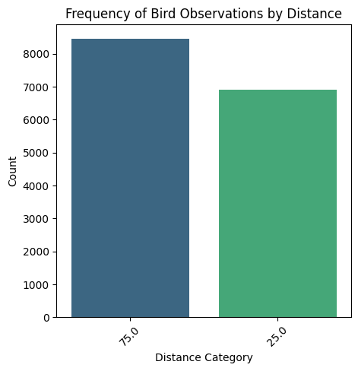
Distance and Behaviour
Distance Analysis: Evaluate the Distance column to identify species typically observed closer or farther from the observer.
Interpretation:
There are more observations at 75.0 meters than at 25.0 meters.
This suggests birds were more frequently observed at a
greater distance.

Slide 16
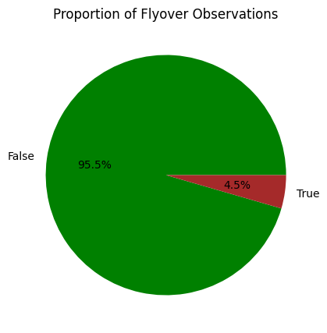
Flyover Frequency: Examine the Flyover_Observed column to detect trends in bird behavior during observation.
Interpretation:
It shows a clear dominance of one category over the other:
False (95.5%) – meaning most bird observations were not flyovers.
True (4.5%) – only a small fraction were observed flying overhead.
Majority of birds were observed in stationary or non-flyover behaviors.
This could include Resting, Searching for food, nesting, etc.

Slide 17
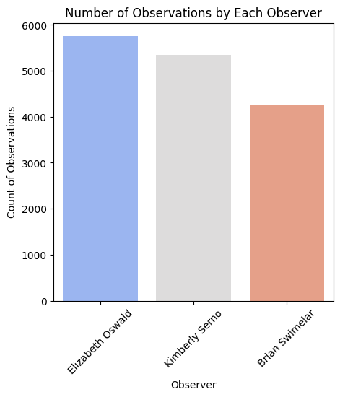
Observer Trends
Observer Bias: Analyze data by Observer to check if specific individuals report more observations or certain species.
Interpretation:
Elizabeth Oswald reported the highest number of observations (~5800), suggesting she may be the most active or available observer.
Kimberly Serno followed closely with slightly fewer records (~5400).
Brian Swimelar had the least (~4300), which might reflect fewer field visits, different locations, or varied effort.

Slide 18
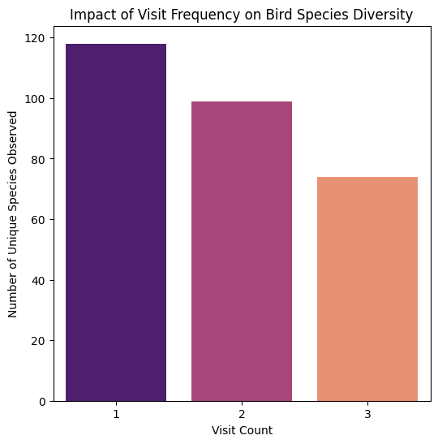
Visit Patterns: Evaluate the Visit column to see how repeated visits affect species count or diversity.
Interpretation:
First visits yielded the highest number of unique bird species (~118).
Second visits showed a moderate decrease in species observed (~99).
Third visits revealed the lowest diversity (~74 species).
Repeated visits tend to observe fewer new species suggesting that most species are detected early in the survey period.

Slide 19
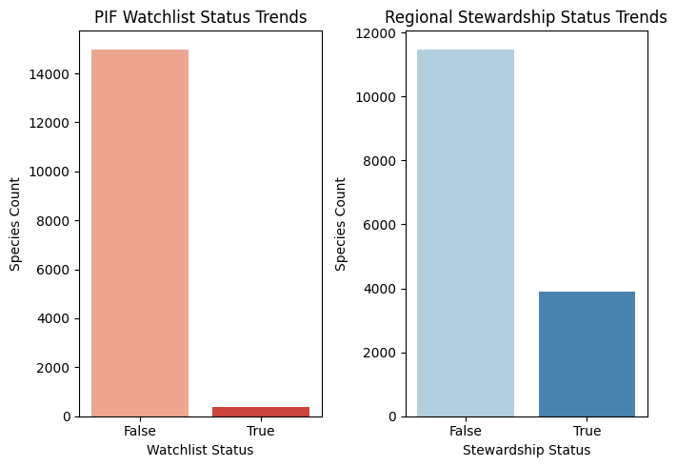
.Conservation Insights
Watchlist Trends: Use the PIF_Watchlist_Status and Regional_Stewardship_Status to identify trends in species that are at risk or require conservation focus.
Interpretation:
Only a small portion of observed species are on the PIF Watchlist, indicating relatively few species at high conservation risk.
A larger number fall under Regional Stewardship, highlighting species that may need targeted protection in specific areas.
This trend supports prioritizing regional efforts alongside broader conservation strategies.

Slide 20
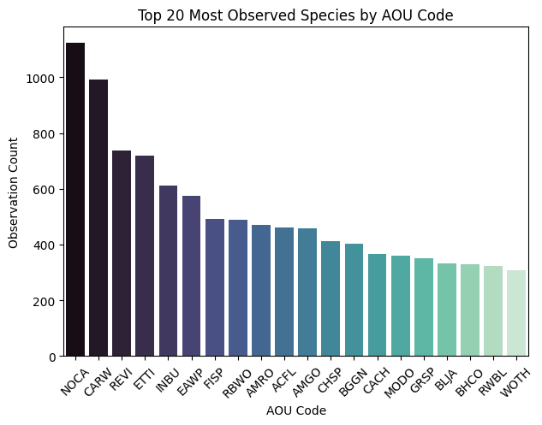
AOU Code Patterns: Study the distribution of species based on their AOU_Code to correlate with regional or national conservation priorities.
Interpretation:
Species with AOU codes like NOCA and CARW have the highest observation counts, indicating they are common and widespread.
The distribution reflects frequent sightings of familiar species, possibly due to habitat preference or detectability.
These trends can help identify which species dominate the region and which may require less frequent but more targeted monitoring.

